Slide 1
User-Driven Input Devices

Slide 2
Introduction to Input Devices
Simply put, an input device is anything that sends information to the computer. This can be in the form of a user-initiated event (like pushing a button), or can be caused by a sensor (i.e. PIR motion sensor).
It is important to note that input devices are either analog or digital.
In either case, the computer receives information, and it is up to the programmer to dictate what the computer will do with that information.

Slide 3
Analog Vs. Digital
While this can be a topic to be explored all on its own, for the purposes here, we can limit it to a brief discussion:
Analog and digital signals are used to transmit information, usually through electric signals. In both these technologies, the information, such as any audio or video, is transformed into electric signals. The difference between analog and digital technologies is that in analog technology, information is translated into electric pulses of varying amplitude. In digital technology, translation of information is into binary format (zero or one) where each bit is representative of two distinct amplitudes.

Slide 4
Analog
While analog signals may be limited to a range of maximum and minimum values, there are still an infinite number of possible values within that range. For example, the analog voltage coming out of your wall socket might be clamped between -120V and +120V, but, as you increase the resolution more and more, you discover an infinite number of values that the signal can actually be (like 64.4V, 64.42V, 64.424V, and infinite, increasingly precise values).
The analog signals we use will be clamped between 0V and +5V(or 3.3V). Always be careful when you are connecting an analog sensor to your raspberry pi.

Slide 5
Digital
Digital signals must have a finite set of possible values. The number of values in the set can be anywhere between two and a-very-large-number-that's-not-infinity. Most commonly digital signals will be one of two values -- like either 0V or 5V. Timing graphs of these signals look like square waves.
For a more in-depth discussion on analog vs. digital inputs, refer to this resource.

Slide 6
User-Driven Input Devices
Here are the input devices that we have available to us:
Digital
Explorer Hat Touchpads (1-8)
Push Buttons Analog
Slider
Potentiometer
Joystick
** the joystick is basically two potentiometers in one(x and y)

Slide 7
Touchpads
The touchpads function like a button. They can detect when your finger is placed on them and when you remove your finger.
See the github page for more information.
One thing to take note of is that when you use the touchpads to call a function there will be two arguments passed to the function. You don’t have to use them, but your code has to account for them or you will get an error. The two arguments are channel and event. The channel is the number for the touchpad you used and the events are either ‘press’ or ‘release’.

Slide 8
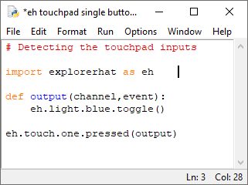
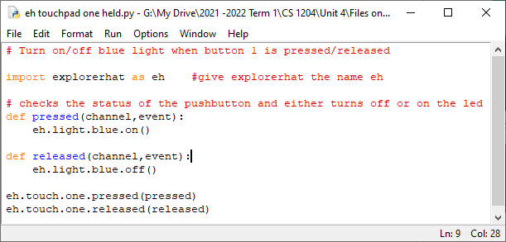
Touchpad Examples(using onboard leds)

Slide 9
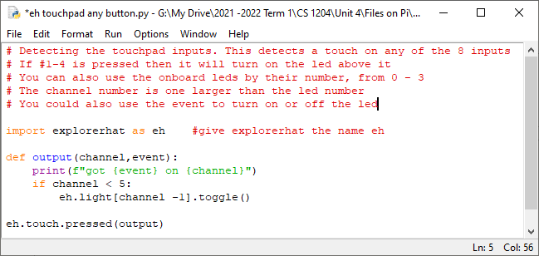
Can you make a program that will control a motor using the touchpads?

Slide 10
Push Button
We will be using normally-open momentary push buttons. This means that the two contacts are not touching each other until you push the button. There are other types of push buttons and switches that may differ in function, but they all either connect or disconnect two wires.
You have to connect one wire to +5V on your explorer hat and the other wire to one of the 4 inputs.
When you use the inputs on the explorer hat it will pass an instance of the input to the function you call. See the examples on the next page, and see the github page for more information.

Slide 11
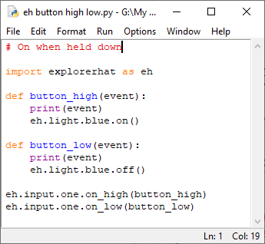
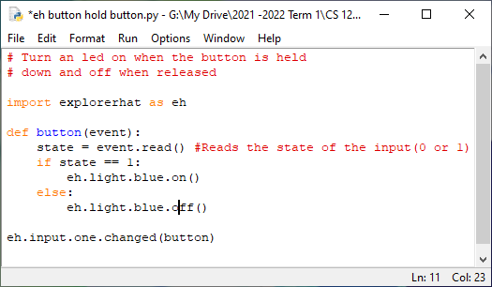
External Push Button Examples
Is there any difference between the outcome of these two examples?

Slide 12
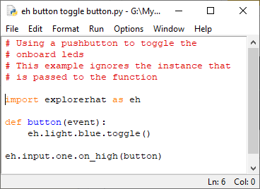

Slide 13
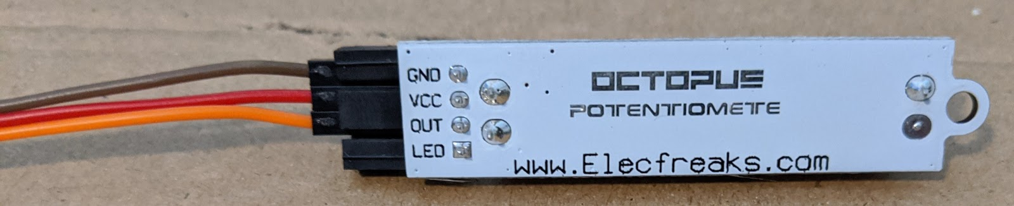
Analog Inputs
The slider, potentiometer, and joystick all work the same way. The joystick also has a push button, like game controllers do.
The slider and potentiometer require three connections. One to ground(GND), one to +5V(VCC), and the other to one of the analog inputs(OUT).

Slide 14
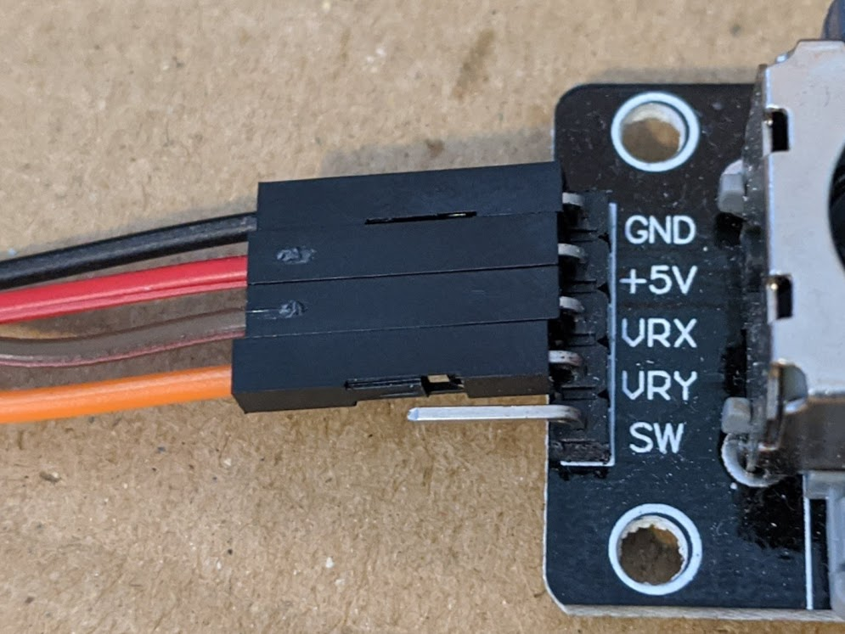
On the potentiometer the middle leg goes to one of the analog inputs. If you want to change which direction increases the reading then you can switch ground and +5V.
The joystick has two outputs, VRX and VRY for the x and y axis. Each will go to an analog output.
The analog inputs pass two arguments to your functions. The ‘pin’ number and the ‘value’.

Slide 15
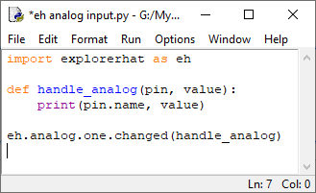
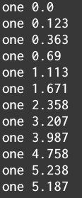
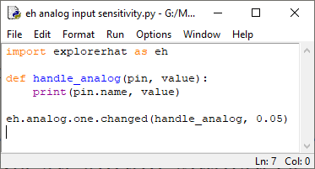
Analog Examples
Do this one first
This will give an output similar to what is shown to the right.
What happens if you move the slider, or dial very slowly?
You can also include a sensitivity value, which is how much the voltage must change for it to be detected(experiment with values).

Slide 16
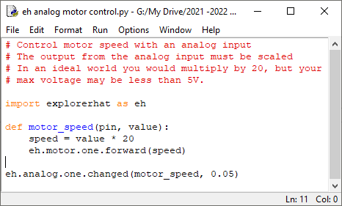
Motor Control
Try to make it so that you can control the speed and direction with the slider. You will need to use the eh.motor.one.speed() instead of forward and reverse.

Slide 17
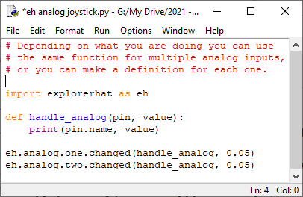
Joystick

Slide 18
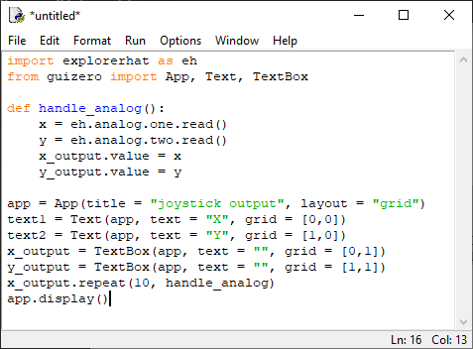
Using guizero to show values
If the values in the textboxes are not updating then you may need to change the interval for the repeat to be a larger number than 10.

